Slide 1
Mine Sweep Battle
Team members
6 Mihkel Roomet
34 Kaarel Koido
39 Muruganantham Jaisankar

Slide 2
Summary
What is your aim?
Your aim is to gather more points than the opposing players during a game of minesweeper.
How do you begin and what do you do?
You get spawned in an open area onto a minesweeper board. You start clearing the board by shooting at tiles around you.
How does the game respond to your actions?
The game reveals whether the tile you shot at was a bomb or not. If you guessed correctly, the tile will open. If not, you get stunned.

Slide 3
Summary
4. What changes in game over time or as you progress?
The field opens up and you meet other players, whom you can also shoot at :)
5. What must you do to keep up with the game progress?
Keep up the scoring and dodge an increasing number of enemy attacks.
6. How does the player fail and succeed?
You can win the game by accumulating the most points of any player, by clearing tiles and killing competitors.

Slide 4
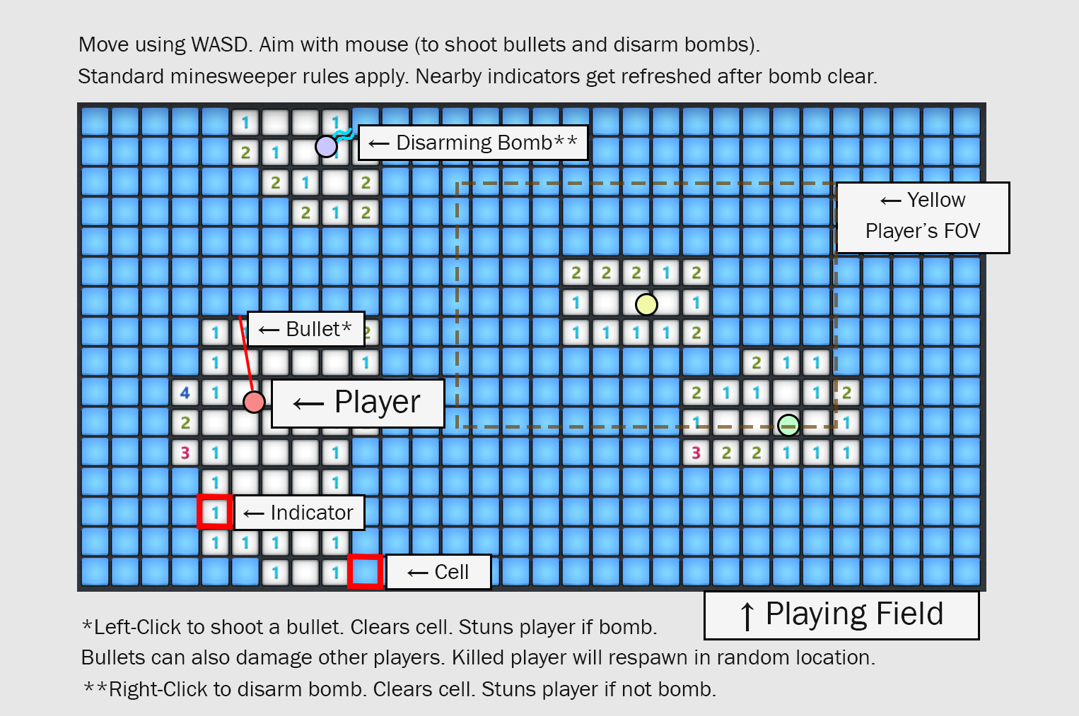

Slide 5
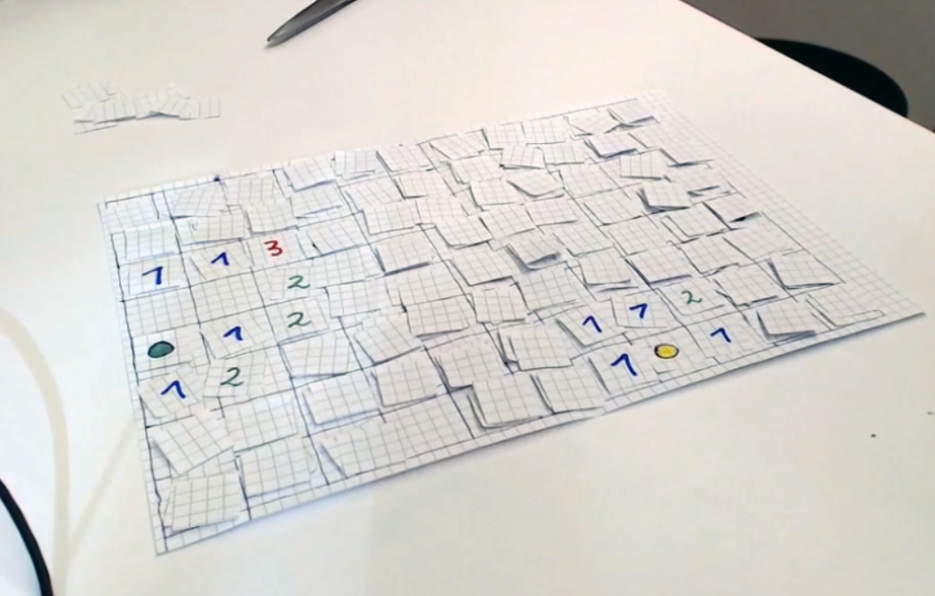

Slide 6
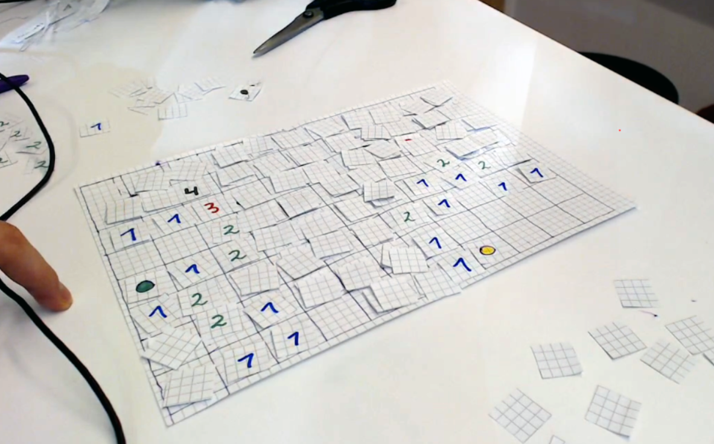

Slide 7
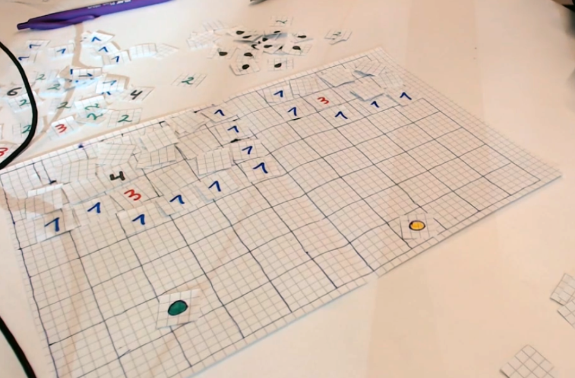

Slide 8
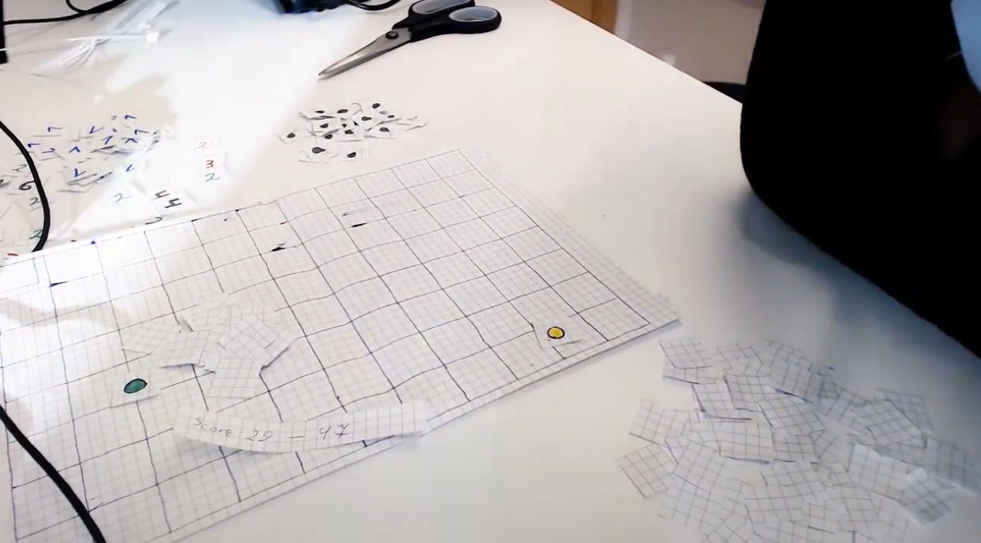

Slide 9
List of tasks for Minimal Viable Product (MVP)
Working mini-size game board (30x16)
Static locations of bomb cells and clear cells
Static starting location
Working indicators that also auto-refresh on bomb clear
Player object
Player controls
Player movement (WASD)
Player can shoot (left-click)
Disarming a mine (right-click)

Slide 10
List of tasks for Minimal Viable Product (MVP)
4) Working camera centered around player
5) Working score indicator

